Slide 1
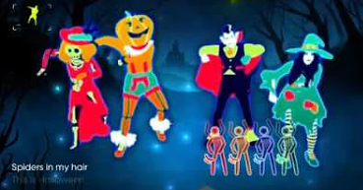
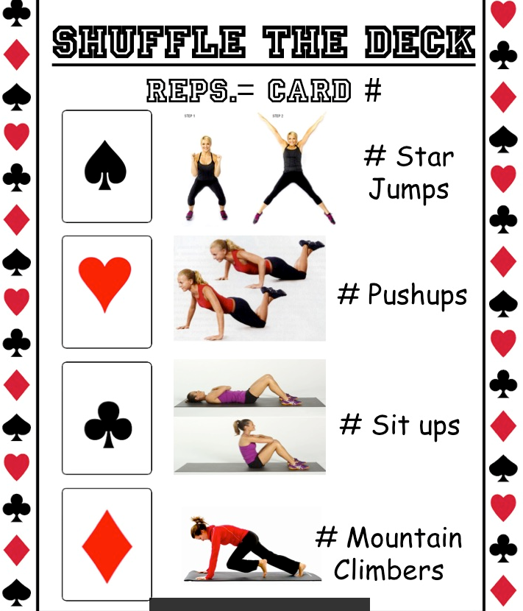
Physical Education at Home
November, 1 – 5, 2021
Hello Coyote Families! Please find some activities that you can do alone or together!
Monday Try this fun & active Halloween themed Just Dance playlist on YouTube. https://www.youtube.com/results?search_query=just+dance+halloween | Tuesday Try this plank challenge! How long can you last? Can you complete the whole challenge? https://www.youtube.com/watch?v=rACy-0g1CuY If that link doesn’t work for you, you can search YouTube for ‘Bring Sally Up plank Challenge’ (by Focused Fitness) *Or without using YouTube, you can challenge yourself to perform a plank for as long as you can. Time yourself.
Wednesday Find a safe object to practice tossing and catching (soft ball, a pair of socks). With a family member - start close together (approximately 4 steps apart). Take turns tossing & catching. Each time you successfully toss & catch – take a step back. How far apart can you get? How many successful tosses & catches can you make in a row? Set a goal. | Thursday Take turns flipping a card, the number on the card is how many of the action You need to do
Friday Yoga!! Pick a 30 minute yoga program. Go Noodle or Cosmic yoga is a fun spot to find age appropriate programs. | Bonus Activity Get outside!!. As a family, go for a nice long walk. While on your long walk, challenge yourself to jog to a power pole, or to the next mailbox. Have fun with it. See if you are able to push yourself to try jogging for 1 minute.

